Slide 1
INBOUND PROCESS IMPROVEMENT

Slide 2
Inbound process automation
Currently after scan and finalize ASN, we need to go to ASN maintenance to update HAWB, the information are already in reference1, can just direct link to it.
And we need to manual update “Date1” based on actual physical receiving time, this time can be capture from HAWB scan time, the HAWB scan time was updated by program utility -> “update inbound HAWB arrive date”.
For “Place of Discharge” also can be updated automatically based on pack slip no., currently there is no logic been built in system, I will come out a logic sheet later and can use code maintenance program to manage it, if any change in the future. The sheet will provide to you later.
For finalize ASN program also do some improvement to default NC shipment as N, coz NC rate only 0.18% of overall inbound shipment, the default solution can apply to rest of 99.82% shipments.

Slide 3
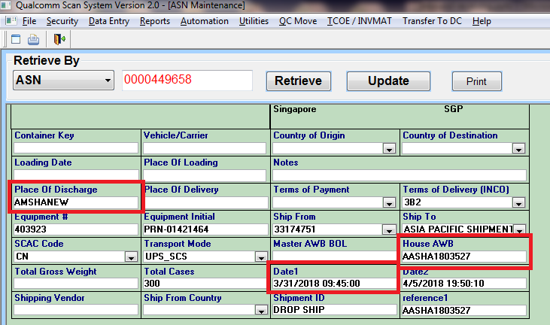

Slide 4
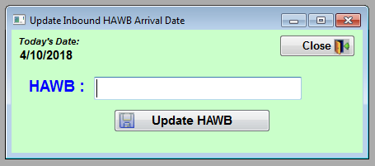

Slide 5
